Slide 1

JS Back-End
Course Introduction
SoftUni Team
Technical Trainers
Software University
https://softuni.bg/

Slide 2
Table of Contents
Module Overview
Course Objectives
Training and Team
Course Organization

Slide 3
Have a Question?
sli.do
#js-web

Slide 4














SoftUni Diamond Partners

Slide 5

JS Web

Slide 6
JS Web Module Goals
3 months intensive JavaScript framework training
2 times weekly, lots of live coding and workshops
Part I - JS Back-End
Node.js, Express.js, MongoDB + Mongoose, JWT, Rest API
Part II - React.js
JSX, Components, Routing, Forms, React Hooks, Context API

Slide 7
JS Web Module – Timeline
19-May-2020
30-June-2020
16-Aug-2020
JS Back-End
6 weeks * 2 times / week
9 credits
Start: 19-May-2020
Final exam: 28-June-2020
React.js
6 weeks * 2 times / week
15 credits
Start: 30-June-2020
Project Defense: 16-Aug-2020
Re-Take Exams
JS Back-End - 19 Aug
ReactJS - 23 Aug

Slide 8

Course Objectives

Slide 9
Course Objectives
Extend the skills, gained in JS Advanced, by introducing server-side JavaScript technologies
Learn to use the most common techniques in web development
Apply the fundamentals of application architecture and code convention through the MVC pattern
Requirements
HTML & JS (ES 2016) coding skills - intermediate level
Computer English - entry level

Slide 10

Course Topics
Introduction to Node.js
Node Streams & Utilities
ExpressJS & Templating
NoSQL & MongoDB & Mongoose
Session & Authentication
Validation & Error Handling
Workshop: Building a REST API

Slide 11

The Trainers Team

Slide 12
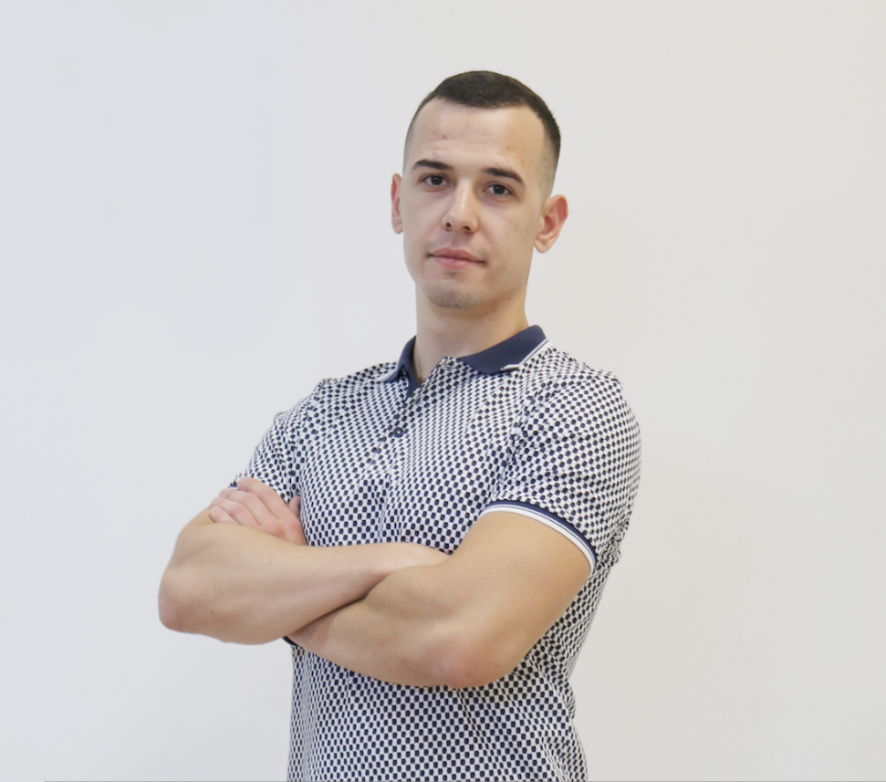
Valentin Georgiev
Lead Software Engineer
Co-organizer
Serverless Bulgarian Meetups
Speaker on
jsTalks()
React
Developer with entrepreneur mindset

Slide 13

Course Organization

Slide 14
Practical Exam
Link to last Express.js Exam
Structure: Server-Side Rendering App for 4 hours
Implement CRUD operations + login / register / logout
Use Express.js + Handlebars and MongoDB

Slide 15
Theoretical Exam
You will have 30 minutes once you enter
Multiple-choice with 1 correct answer
English
Automated quiz system
Questions will be between 15 and 30
Available online on the day of the practical exam
You can submit your answers just one time

Slide 16


Scoring System for the Course
Theoretical Exam 5%
PracticalExam 95%
Evaluation

Slide 17




Course Web Site, Forum and FB Group
Official web site:
Official discussion forum:
Official Facebook group:
Official SoftUni JavaScript Community:
softuni.bg/trainings/2452/
softuni.bg/forum/categories/107/
www.facebook.com/groups/JSWebMay2020
facebook.com/groups/SoftUniJavaScriptCommunity/

Slide 18



Learn to Search in Internet
The course assignments require to search in Internet
This is an important part of the learning process
Some exercises intentionally have no hints
Learn to find solutions!
Software development includes everyday searching and learning
No excuses, just learn to study!
Developers learn new technologies, tools, languages every day!

Slide 19
Questions?
Notes:
19

Slide 20
Trainings @ Software University (SoftUni)
Software University – High-Quality Education, Profession and Job for Software Developers
softuni.bg
Software University Foundation
softuni.foundation
Software University @ Facebook
facebook.com/SoftwareUniversity
Software University Forums
forum.softuni.bg
Notes:
20

Slide 21

License
This course (slides, examples, demos, exercises, homework, documents, videos and other assets) is copyrighted content
Unauthorized copy, reproduction or use is illegal
© SoftUni – https://about.softuni.bg/
© Software University – https://softuni.bg
Notes:
21

